Slide 1
Presentation of Fundamental Market Metrics
Sub Markets of Los Angeles Region Quarter-over-Quarter Variance Analysis

Slide 2
Key Market Metrics
Market Size (A Inventory)
Vacant Space (SF) Class A (A Overall vacancy SF)
Overall vacancy % Class A
Asking Rent NNN($/Sf) Class A
023 YTD Net Absorption (SF)
Under Construction (SF)
Notes:
Market size is the total available inventory includes vacant plus the occupied space.
Vacant Space is the amount of unoccupied or available commercial real estate space measured in square feet (SF) for a given quarter.
Overall Vacancy % is the portion of the total market size (SF) that is empty at the end of a quarter and measured as the ratio of Vacant space((SF) to the Market size (SF).
Asking rent NNN ($/Sf) is the rent landlords are advising per square foot, on a triple-net (NNN) lease basis, which means the tenant pays the Base Rent (in $/sf monthly or yearly) plus the operating expenses including property taxes, insurance and maintenance).
Net Absorbtion is the difference between Space occupied and the Sapce vacant from year to date (YTD) which means from the start uptil the end of reporting date.
Under Construction is the total amount of commercial real estate (Sf) that is physically being bulit but not yet completed as of the reporting date and once it is completed it moves from under construction into “Market Size” inventory.

Slide 3
Notes:
The Verticla axis reflects the Square feet (SF) and horizontal axis represents the Market Metrics/Categories.

Slide 4
Sub-Markets Comparison
1. West LA dominates in size but suffers high vacancy and worst absorption
• Reason: West LA is the largest market (46.6M SF), but demand has not kept pace with supply.
• Tenants are either downsizing or relocating, leading to negative net absorption (-1.05M SF YTD).
• Vacancy rose despite a small rent increase ($52.00 → $52.25), showing landlords are holding firm on pricing but struggling to fill space.
• Takeaway: Oversupply risk in the largest submarket.

Slide 5
2. Tri-Cities is the best performer (low vacancy, high rents, positive absorption)
• Reason: Tri-Cities (20.4M SF) absorbed +489K SF YTD, which reduced vacancy slightly.
• Strong demand supports high asking rents ($45.50/SF) even after a decline from Q3 ($56.50 → $45.50).
• Tenants likely value this submarket for its accessibility and business clustering effect.
• Takeaway: A healthy submarket with continued tenant interest despite minor rent correction.
Notes:
Market size is the total available inventory includes vacant plus the occupied space.
Vacant Space is the amount of unoccupied or available commercial real estate space measured in square feet (SF) for a given quarter.
Overall Vacancy % is the portion of the total market size (SF) that is empty at the end of a quarter and measured as the ratio of Vacant space((SF) to the Market size (SF).
Asking rent NNN ($/Sf) is the rent landlords are advising per square foot, on a triple-net (NNN) lease basis, which means the tenant pays the Base Rent (in $/sf monthly or yearly) plus the operating expenses including property taxes, insurance and maintenance).
Net Absorbtion is the difference between Space occupied and the Sapce vacant from year to date (YTD) which means from the start uptil the end of reporting date.
Under Construction is the total amount of commercial real estate (Sf) that is physically being bulit but not yet completed as of the reporting date and once it is completed it moves from under construction into “Market Size” inventory.

Slide 6
3. Hollywood/Wilshire is the weakest submarket (highest vacancy, falling rents)
• Reason: With only 7.1M SF of inventory, Hollywood/Wilshire is the smallest market, but still has 28.6% vacancy (~2M SF empty).
• Rents fell sharply ($34.50 → $31.25), suggesting landlords are cutting rates to attract tenants.
• Net absorption was negative (-197K SF), meaning more space vacated than leased.
• Takeaway: Weak demand and limited tenant interest, underperforming relative to its size.
Notes:
Market size is the total available inventory includes vacant plus the occupied space.
Vacant Space is the amount of unoccupied or available commercial real estate space measured in square feet (SF) for a given quarter.
Overall Vacancy % is the portion of the total market size (SF) that is empty at the end of a quarter and measured as the ratio of Vacant space((SF) to the Market size (SF).
Asking rent NNN ($/Sf) is the rent landlords are advising per square foot, on a triple-net (NNN) lease basis, which means the tenant pays the Base Rent (in $/sf monthly or yearly) plus the operating expenses including property taxes, insurance and maintenance).
Net Absorbtion is the difference between Space occupied and the Sapce vacant from year to date (YTD) which means from the start uptil the end of reporting date.
Under Construction is the total amount of commercial real estate (Sf) that is physically being bulit but not yet completed as of the reporting date and once it is completed it moves from under construction into “Market Size” inventory.

Slide 7
LA CBD stable in size, weak absorption, flat rents
• Reason: LA CBD has a large base (24.1M SF), but vacancy stayed high (25.3%).
• Asking rents flat at $29.00, showing landlords are reluctant to lower pricing despite weak absorption (-703K SF).
• Likely reflects tenant preference for suburban submarkets with lower costs and newer product.
• Takeaway: Downtown is stagnant—stable pricing but not absorbing vacant space.
Notes:
Market size is the total available inventory includes vacant plus the occupied space.
Vacant Space is the amount of unoccupied or available commercial real estate space measured in square feet (SF) for a given quarter.
Overall Vacancy % is the portion of the total market size (SF) that is empty at the end of a quarter and measured as the ratio of Vacant space((SF) to the Market size (SF).
Asking rent NNN ($/Sf) is the rent landlords are advising per square foot, on a triple-net (NNN) lease basis, which means the tenant pays the Base Rent (in $/sf monthly or yearly) plus the operating expenses including property taxes, insurance and maintenance).
Net Absorbtion is the difference between Space occupied and the Sapce vacant from year to date (YTD) which means from the start uptil the end of reporting date.
Under Construction is the total amount of commercial real estate (Sf) that is physically being bulit but not yet completed as of the reporting date and once it is completed it moves from under construction into “Market Size” inventory.

Slide 8
5. El Segundo/Beach Cities volatile: rising vacancy, slight rent decline
• Reason: Smaller market (8.05M SF) but volatile demand. Vacancy jumped from 1.93M → 2.22M SF, raising vacancy % to 27.6%.
• Rent declined slightly ($36.25 → $35.00), signaling landlords adjusting expectations.
• Despite positive YTD absorption (+149K SF), the Q4 vacancy increase shows late-year tenant move-outs outweighed gains.
• Takeaway: Unstable submarket with swings between leasing gains and tenant exits.
Notes:
Market size is the total available inventory includes vacant plus the occupied space.
Vacant Space is the amount of unoccupied or available commercial real estate space measured in square feet (SF) for a given quarter.
Overall Vacancy % is the portion of the total market size (SF) that is empty at the end of a quarter and measured as the ratio of Vacant space((SF) to the Market size (SF).
Asking rent NNN ($/Sf) is the rent landlords are advising per square foot, on a triple-net (NNN) lease basis, which means the tenant pays the Base Rent (in $/sf monthly or yearly) plus the operating expenses including property taxes, insurance and maintenance).
Net Absorbtion is the difference between Space occupied and the Sapce vacant from year to date (YTD) which means from the start uptil the end of reporting date.
Under Construction is the total amount of commercial real estate (Sf) that is physically being bulit but not yet completed as of the reporting date and once it is completed it moves from under construction into “Market Size” inventory.

Slide 9
Standout Negative Trend – West LA
Metric: Asking Rent (NNN $/SF Class A)
3Q23: $41.50 | 4Q23: $36.25 | Variance: –$5.25 (–12.7%)
Vacant space rose by +602,559 SF in the same period
Factors: Tenant move-outs, sublease supply, landlord concessions
Inference: Decrease demand in historically over flowing rent in submarket

Slide 10
Standout Positive Trend – Tri-Cities
Metric: Net Absorption (SF)
3Q23: 489,301 | 4Q23: 268,209 | Still positive
Vacancy rose slightly: 21.9% → 22.7%
Factors: More affordable rents, diversified tenant mix
Implication: Resilient demand compared to other submarkets

Slide 11
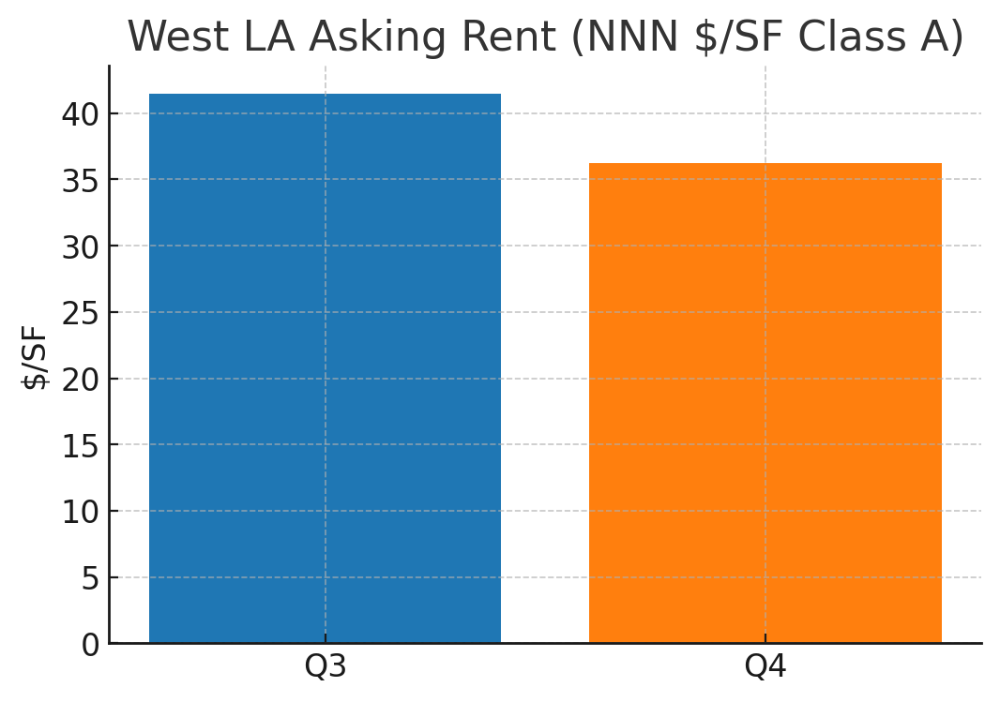

West LA Asking Rent Trend

Slide 12
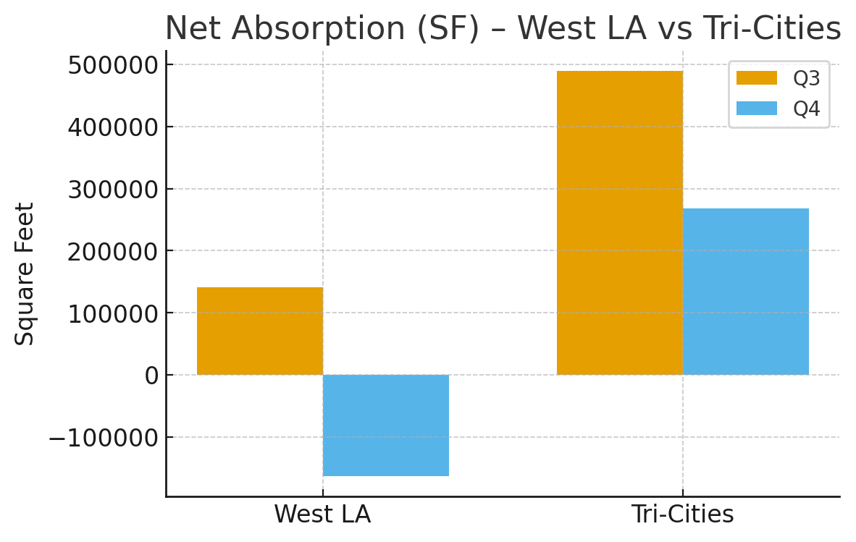
Net Absorption – West LA vs Tri-Cities

Slide 13
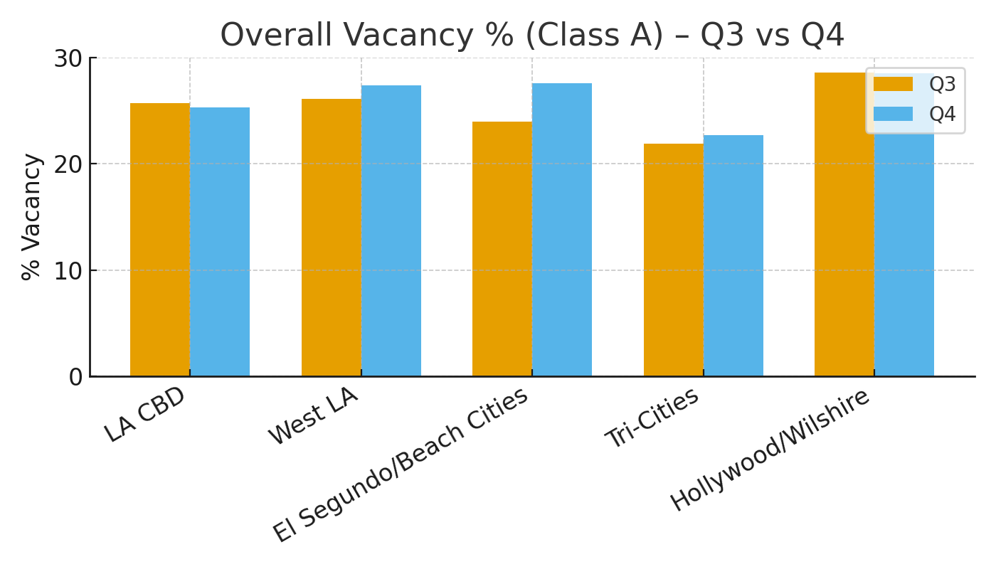
Overall Vacancy % (Class A) – Q3 vs Q4

Slide 14
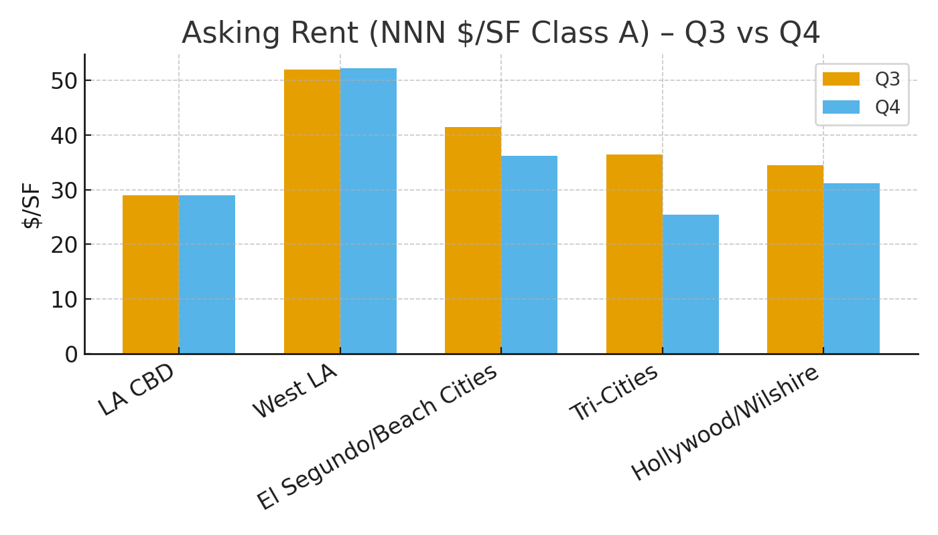
Asking Rent (NNN $/SF Class A) – Q3 vs Q4

Slide 15
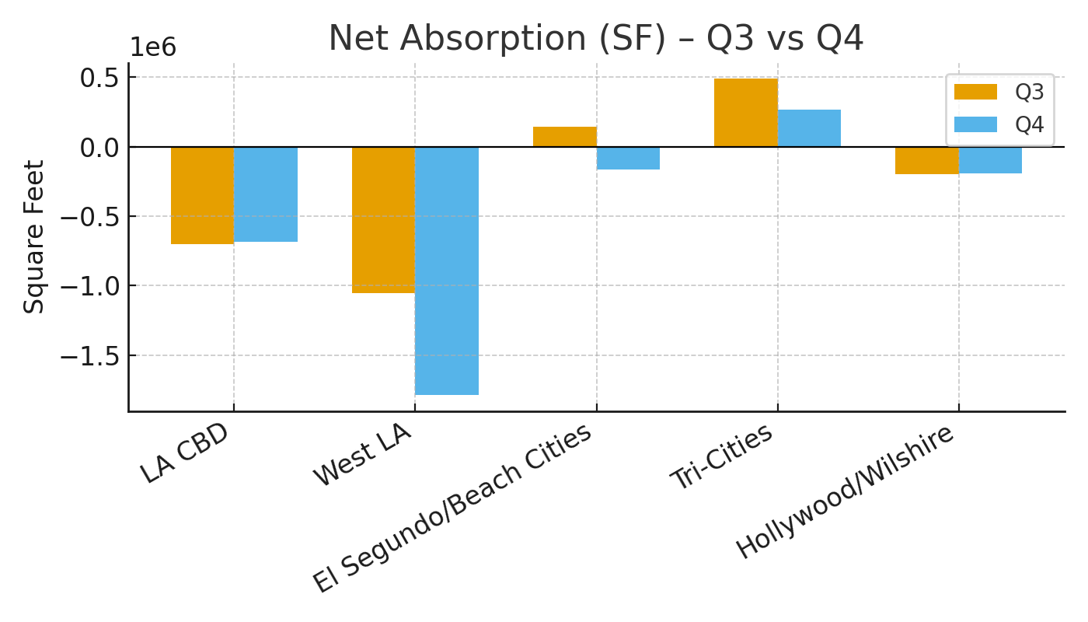
Net Absorption (SF) – Q3 vs Q4

Slide 16
SUMMARY – LA Office Market Trends
West LA: Largest negative shift/displacement, rents declined sharply and vacancy rose
Tri-Cities: Demonstrated relative strength with current absorption and social process
Market Prospective: Submarkets diverging – some show resilience while others weaken
Recommendation: Supervise rent trends in West LA; highlight stability and firmness in Tri-Cities

